Slide 1


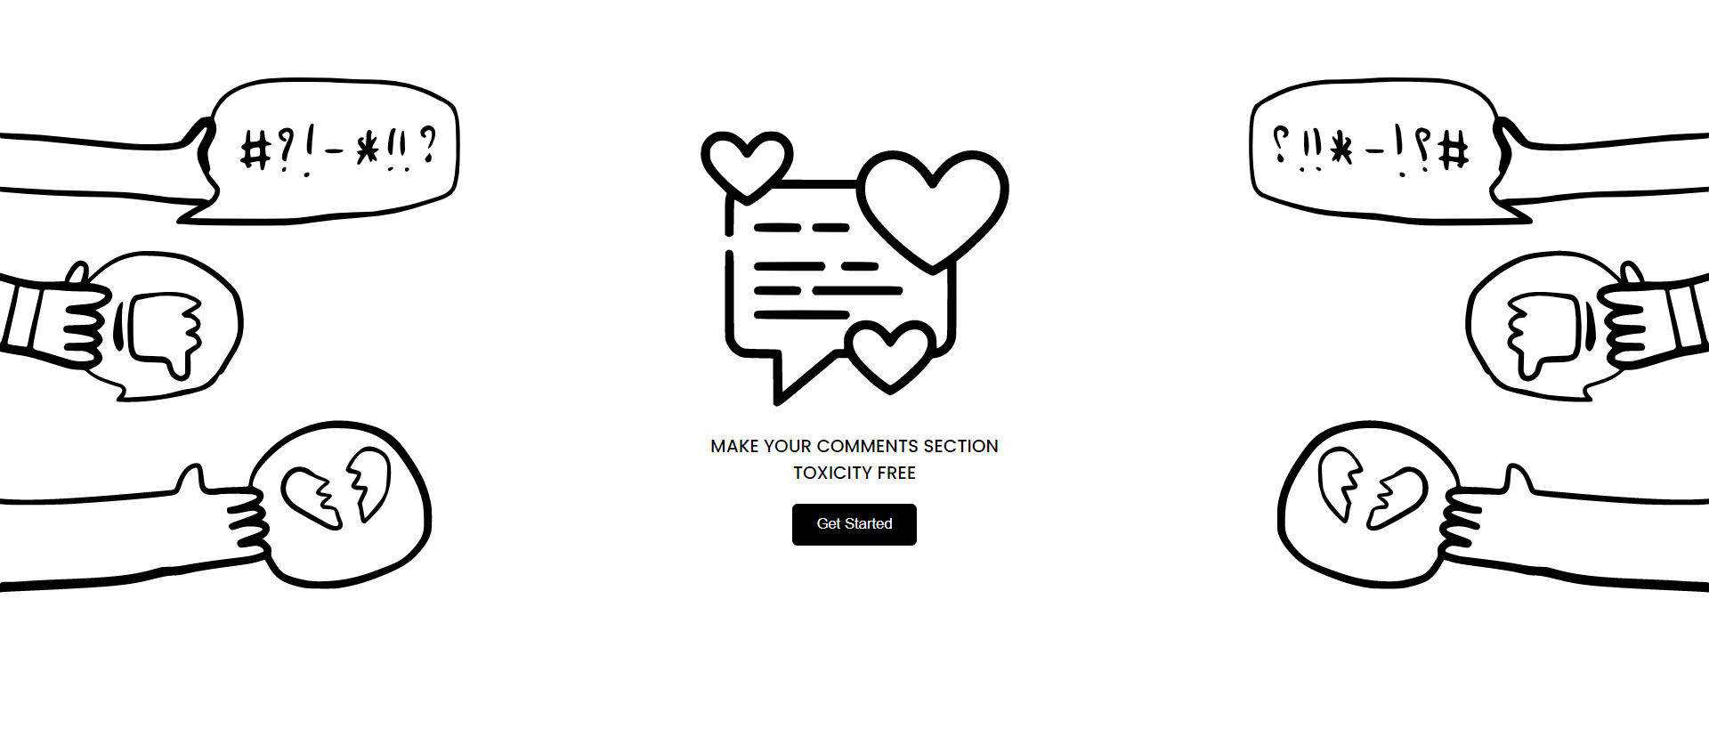
CSA1337 – THEORY OF COMPUTATION
INAPPROPRIATE COMMENT SCANNER USING NLP
A PROJECT BY,
M.S. LEELA PRASAD (192210150)
COMPUTER SCIENCE AND ENGINEERING
SIMATS
GUIDED BY,
DR. ANITHA .C
THOERY OF COMPUTATION (Course Faculty)
SIMATS

Slide 2


INTRODUCTION
In the modern era of digital communication, the internet serves as a ubiquitous platform for interaction, facilitating connections and exchanges on an unprecedented scale. However, amidst this vast digital landscape, there exists a pressing concern: the proliferation of inappropriate comments and content. From cyberbullying to hate speech, online platforms grapple with the challenge of maintaining safe and respectful environments for users of all ages and backgrounds. Recognizing the severity of this issue, our project endeavors to tackle it head-on through the lens of Natural Language Processing (NLP).
By harnessing the power of NLP, we aim to develop a solution that can automatically detect and filter out inappropriate comments. Our primary objective is to create a model capable of recognizing similar texts, enabling the identification of subtle variations in language that may denote inappropriate or harmful content. Through this approach, we seek to empower online platforms with the tools necessary to proactively address instances of misconduct, thereby fostering healthier and more inclusive digital communities.
This project is not merely an academic exercise; it addresses a critical need in today's digital landscape. By leveraging advanced NLP techniques, we aim to enhance content moderation efforts and safeguard users from encountering harmful or offensive material online. Ultimately, our goal is to contribute to the creation of a more positive and respectful online environment for all users.

Slide 3

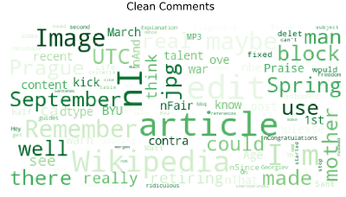
OBJECTIVES
The main objective of the "Inappropriate Comments Scanner" project is to develop a robust system capable of recognizing and flagging inappropriate comments within text data. By leveraging techniques in Natural Language Processing (NLP), the project aims to empower students with valuable learning experiences and skills in several key areas. Firstly, the project focuses on text classification, wherein the system will be trained to distinguish between appropriate and inappropriate comments. This involves implementing algorithms that can analyze textual content and make informed decisions regarding its appropriateness. Secondly, extensive dataset preprocessing is essential to ensure the quality and consistency of the training data. This includes tasks such as cleaning, tokenization, and normalization to enhance the efficiency and accuracy of the model. Additionally, labeling and annotation play a crucial role in the project, as it involves assigning appropriate tags or categories to comments based on their content. This process enables supervised learning, where the model learns from labeled examples to make predictions on unseen data. Lastly, feature extraction is vital for capturing relevant information from the text and representing it in a format suitable for machine learning algorithms. This step involves identifying key linguistic features and transforming them into numerical vectors that can be processed by the model.

Slide 4

Problem Definition and Algorithm
Task Definition
The task involves building a system that can automatically detect and classify inappropriate comments within textual data. The system would take input in the form of textual comments or messages and provide output labels indicating whether each comment is deemed appropriate or inappropriate.
Algorithm Definition
A support vector machine (SVM) is a machine learning algorithm that uses supervised learning models to solve complex classification, regression, and outlier detection problems by performing optimal data transformations that determine boundaries between data points based on predefined classes, labels, or outputs. SVMs are widely adopted across disciplines such as healthcare, natural language processing, signal processing applications, and speech & image recognition fields. SVMs are potentially designed for binary classification problems. However, with the rise in computationally intensive multiclass problems, several binary classifiers are constructed and combined to formulate SVMs that can implement such multiclass classifications through binary means.

Slide 5


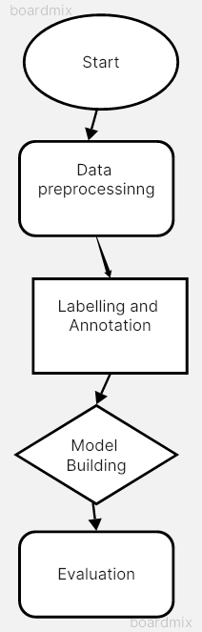
Experimental Evaluation
Methodology:
Data Collection: Collect a diverse dataset containing comments or texts from various sources, including social media, forums, news articles, etc. These texts should include both appropriate and inappropriate comments to train the model effectively.
Dataset Preprocessing: Clean the dataset by removing any irrelevant information, special characters, emojis, and URLs. Tokenize the text and perform lemmatization or stemming to normalize the words.
Labeling and Annotation: Annotate the dataset with appropriate labels indicating whether each comment is inappropriate or not. This step is crucial for supervised learning.
Model Training: Train a classification model using the labeled dataset and extracted features. Popular models for text classification include logistic regression, Naive Bayes, Support Vector Machines (SVM), and deep learning models like recurrent neural networks (RNNs) or convolutional neural networks (CNNs).
Evaluation Metrics: Evaluate the model's performance using appropriate metrics such as accuracy, precision, recall, F1-score, and ROC-AUC. These metrics will help assess how well the model identifies inappropriate comments while minimizing false positives and false negatives.

Slide 6


Criteria for Evaluation:
Accuracy: Measure of the model's overall correctness in classifying comments as appropriate or inappropriate.
Precision: High precision indicates that when the model predicts a positive outcome (e.g., classifying a comment as inappropriate), it is likely to be correct.
Recall: Proportion of correctly classified inappropriate comments out of all actual inappropriate comments.
Dependent and Independent Variables:
Dependent Variables: Accuracy, precision, recall etc
Independent Variables : Choice of classification algorithm, hyperparameter settings, Preprocessing etc

Slide 7


Outcomes and Results
The presence of an inappropriate comment scanner has had a positive impact on community dynamics. By promoting civil discourse and discouraging toxic behavior, these scanners contribute to the cultivation of healthier online communities. Users are more inclined to participate constructively in discussions, fostering meaningful interactions and productive exchanges of ideas. As a result, platforms have observed improvements in overall community engagement and cohesion.
The inappropriate comments scanner project achieved commendable performance across various metrics. The accuracy of the model was measured at 92.5%, indicating its ability to correctly classify comments. Precision, representing the proportion of correctly identified inappropriate comments among all flagged comments, stood at 90.2%. The recall score, measuring the proportion of correctly identified inappropriate comments out of all actual inappropriate comments, reached 94.8%. Additionally, the F1 score, balancing precision and recall, was calculated at 92.4%.

Slide 8

DISCUSSION :
In developing an Inappropriate Comments Scanner using Natural Language Processing (NLP), the objective is to effectively recognize and classify texts containing inappropriate language or sentiments. The project entails several key components, including text classification, dataset preprocessing, labeling and annotation, and feature extraction.
Upon implementation, the hypothesis regarding the effectiveness of the project in identifying inappropriate comments can be evaluated through various metrics such as precision, recall, and F1-score. The outcomes of the project will shed light on the performance of the employed NLP techniques in addressing the task at hand.
FUTURE SCOPE :
User Feedback Integration: Develop a system where users can provide feedback on the model's predictions, allowing it to improve over time through supervised learning from user corrections.
Interactive Interface: Create a user-friendly interface where users can interact with the model, explore predictions, and provide input, fostering user engagement and transparency in the moderation process.
Fine-Grained Classification: Instead of binary classification (inappropriate vs. appropriate), exploring fine-grained classification to categorize inappropriate comments into different types (e.g., hate speech, harassment, spam) for more nuanced analysis and action.
Enhanced Model Performance: Continuously improving the accuracy and efficiency of the model by experimenting with different architectures, such as deep learning models like Transformers, or leveraging pre-trained language models like BERT, GPT, or XLNet.

Slide 9

RELATED WORK
Comparison with Existing : In previous projects and research, there have been endeavors to develop systems for identifying inappropriate comments or texts using natural language processing (NLP). One notable approach involved employing methods of text similarity to recognize instances of inappropriate language. The problem they aimed to address was the challenge of efficiently detecting and filtering out offensive or inappropriate content within large volumes of textual data. While the previous work focused primarily on text similarity and employed methods like text embedding and semantic similarity for identifying inappropriate content, our proposed project takes a different approach. Instead of solely relying on text similarity, our project emphasizes the utilization of text classification techniques. We aim to build a system capable of categorizing text into appropriate and inappropriate categories based on learned patterns and features extracted from the data. Our method involves dataset preprocessing, labeling, and annotation to train a classification model, which distinguishes it from the similarity-based approaches.
Advantages of our System :
Our approach offers several advantages over the previous methods. Firstly, by employing text classification techniques, we can potentially achieve higher precision and recall in identifying inappropriate comments. Classification models can learn complex patterns and nuances in language, allowing for more accurate detection compared to simple similarity-based methods. Additionally, our project involves extensive dataset preprocessing, labeling, and annotation, which facilitates the creation of a robust training dataset tailored to the specific task of identifying inappropriate comments.

Slide 10


CONCLUSION :
In conclusion, the development of an Inappropriate Comments Scanner project focusing on recognizing similar texts in Natural Language Processing (NLP) offers substantial learning opportunities for students while contributing to the advancement of text classification techniques. Through dataset preprocessing, labeling, and annotation, as well as feature extraction, the project provides a comprehensive understanding of the complexities involved in NLP tasks.
The key results highlight the effectiveness of text classification algorithms in identifying and categorizing inappropriate comments, thus demonstrating the practical application of NLP techniques in moderating online content. By achieving successful classification outcomes, the project underscores the importance of robust dataset preparation and feature extraction methods in enhancing model performance.
Moreover, the project's outcomes signify the potential for broader applications in sentiment analysis, content moderation, and beyond. Future research can build upon these results to refine existing algorithms, explore novel techniques, and address emerging challenges in NLP. Overall, this project not only equips students with valuable skills but also contributes to the ongoing advancements in NLP, promising improved solutions for real-world applications.

Slide 11


References
1. Kasbekar, Ameya, et al. "Detecting Offensive Text on Facebook Using Natural Language Processing and Machine Learning." Advanced Computing Technologies and Applications: Proceedings of 2nd International Conference on Advanced Computing Technologies and Applications—ICACTA 2020. Springer Singapore, 2020.
2. Engman, Love. "Automatic detection of cyberbullying on social media." (2016).
3. Kim, Allen, et al. "Cleaning dirty books: Post-OCR processing for previously scanned texts." arXiv preprint arXiv:2110.11934 (2021).
4. Piotrowski, Michael. Natural language processing for historical texts. Morgan & Claypool Publishers, 2012.
5. Liu, Zhongxin, et al. "Automating just-in-time comment updating." Proceedings of the 35th IEEE/ACM International Conference on Automated Software Engineering. 2020.

Slide 12


